Slide 1
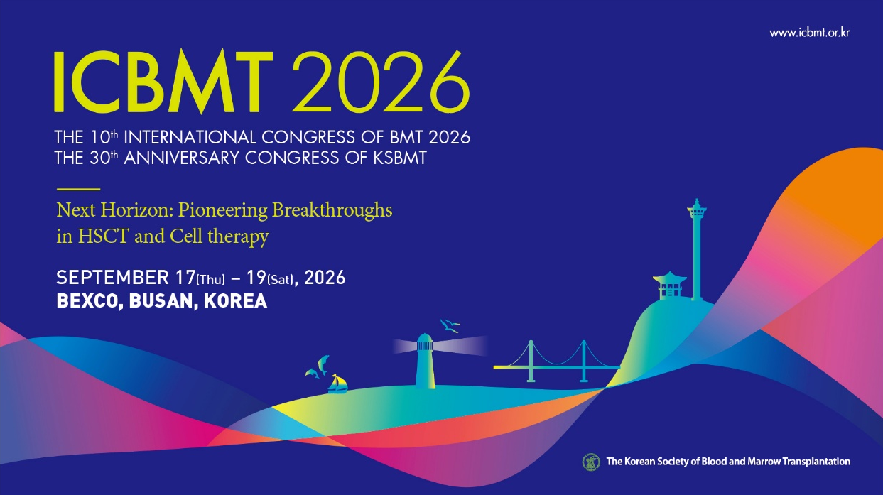

Deadline of Abstract Submission
June 12, 2026
Outstanding
Oral Awards
Overseas
Contribution
Travel Awards
KRW
2,000,000
KRW
1,000,000
KRW
700,000

